Slide 1




Data Science Projects
Ngoc Le

Slide 2
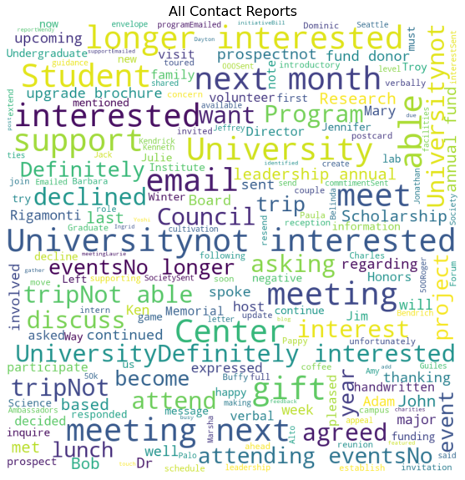
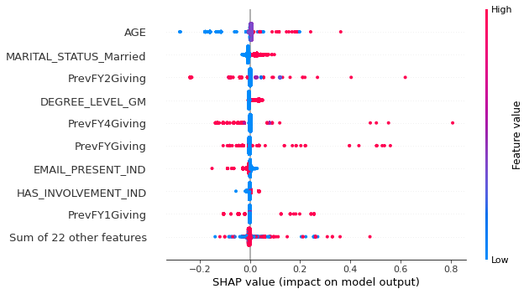
Projects for higher-ed engagement
1. Text analysis to understand the sentiment and topics around contact reports
2. Modeling on constituent base to predict donors for current fiscal year.

Slide 3
Project 1: Text analysis Sentiment analysis and topic modeling
Project Summary:
Created two models that perform sentiment analysis on contact reports to predict the interaction as positive, neutral, or negative using NLP packages VADER and TextBlob.
Created logistic regression models on sentiment scores to predict sentiment of future contact reports.
Visualized the text data accordingly to respective sentiment with wordclouds.
Performed topic modeling on negative contact reports to understand the themes and areas of concern.

Slide 4
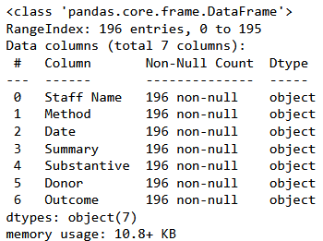
Data Source
A 196 row sample constituent data set with contact reports from the book: Data Science for Fundraising.
Pawlus, M. Fundraising Data, Version 1. Retrieved December 18, 2022 from https://www.kaggle.com/datasets/michaelpawlus/fundraising-data?select=data_science_for_fundraising_contact_reports.csv.

Slide 5
VADER model using SentimentIntensityAnalyzer
 | Staff Name | Method | Date | Summary | Substantive | Donor | Outcome | score | compound | Sentiment
191 | Rashi Mohinder | Visit | 8/27/2017 | Definitely interested in the University and wo... | N | Ben Johnson | Positive | {'neg': 0.0, 'neu': 0.503, 'pos': 0.497, 'comp... | 0.7845 | Positive
192 | Rashi Mohinder | Email | 8/27/2017 | not interested in the University | N | Adam Panda | Negative | {'neg': 0.361, 'neu': 0.639, 'pos': 0.0, 'comp... | -0.3089 | Neutral
193 | April Catson | Visit | 8/27/2017 | not interested in the University | N | Billy Gross | Negative | {'neg': 0.361, 'neu': 0.639, 'pos': 0.0, 'comp... | -0.3089 | Neutral
194 | April Catson | Phone | 8/27/2017 | not interested in the University | N | Carrie Booker | Negative | {'neg': 0.361, 'neu': 0.639, 'pos': 0.0, 'comp... | -0.3089 | Neutral
195 | April Catson | Visit | 8/27/2017 | Definitely interested in the University and wo... | N | Dori Keller | Positive | {'neg': 0.0, 'neu': 0.503, 'pos': 0.497, 'comp... | 0.7845 | Positive
Using VADER model, created new sentiment feature which includes Positive, Neutral, and Negative labels. ‘Outcome’ is the label from the dataset while score, compound, and sentiment are output from VADER model.

Slide 6
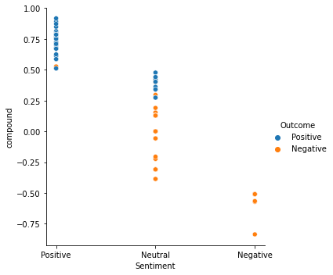
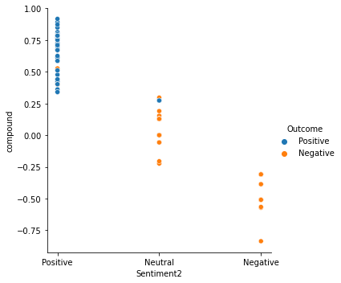
Tuning Models
Compared results from sentiment analysis with outcome and adjusted parameters for newer version called sentiment2.

Slide 7
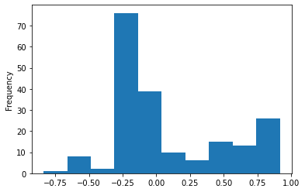
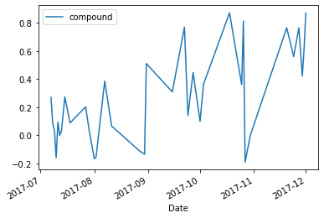
Reviewing sentiment overall and over time
Reviewing the distribution of sentiment scores (compound) and how they have changed over time.

Slide 8
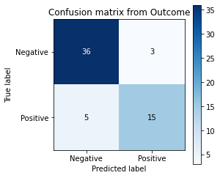
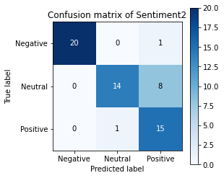
Evaluating Logistic Regression Models
Model Name | Recall for Positive Contact Reports
Sentiment 2 | 0.94
Base Model: Outcome | 0.75
Textblob | 0.67
Sentiment | 0.56
Evaluating the models by reviewing the confusion matrix. Focusing on recall for positive contact reports to highlight opportunities of engagement. Recall for negative contact reports will also be important to identify concerns.

Slide 9
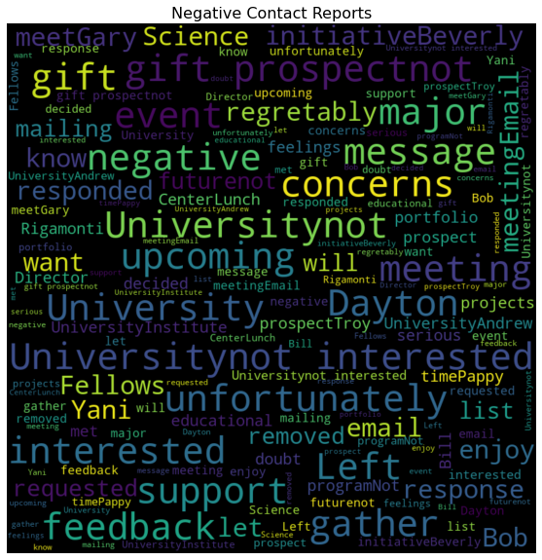
Negative Contact reports
Focusing on negative contact reports identified using the Sentiment 2 model, created a wordcloud.

Slide 10
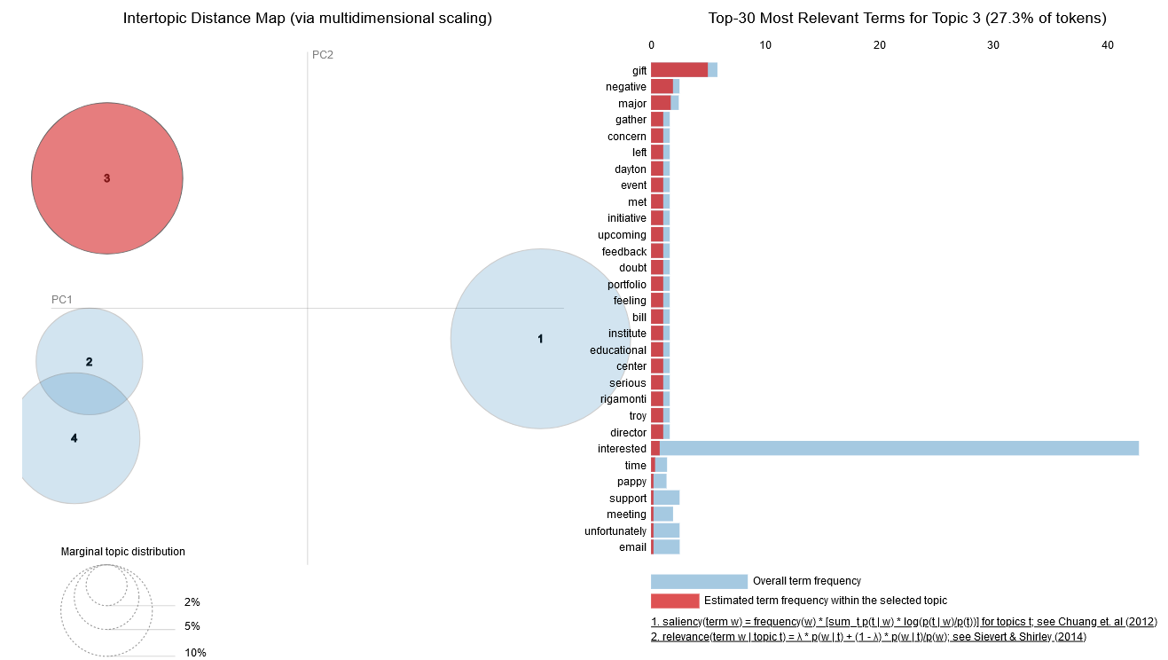
Created LDA model showing potential topics within the text. This visualization is interactive in Jupyter Notebooks.
Example top words for topic 3
Notes:
Latent Dirichlet Allocation (LDA) is an example of topic model and is used to classify text in a document to a particular topic. It builds a topic per document model and words per topic model, modeled as Dirichlet distributions.

Slide 11
Project 2: Predictive Models
Project Summary:
Performed exploratory data analysis to understand the current donors and constituent base.
Created and evaluated 3 models: Logistic regression, KNN, and XGBoost

Slide 12
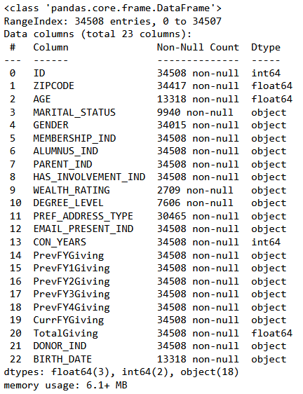
Data source
The data was sourced from Kaggle.
A 34,000 row sample constituent data set from the book: Data Science for Fundraising.
Pawlus, M. Fundraising Data, Version 1. Retrieved December 18, 2022 from https://www.kaggle.com/datasets/michaelpawlus/fundraising-data?select=data_science_for_fundraising_donor_data.csv.

Slide 13
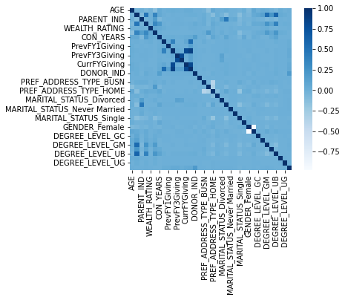
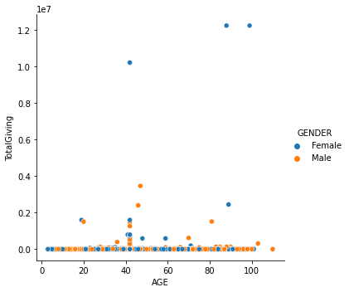
Exploratory analysis
1,845 donors have so far donated in the current fiscal year.
Of these, 92% or 1,689 people that have donated this year were not donors last year.
Notes:
Check balance of classes
sum(y)/len(y)
0.0552329062387738

Slide 14
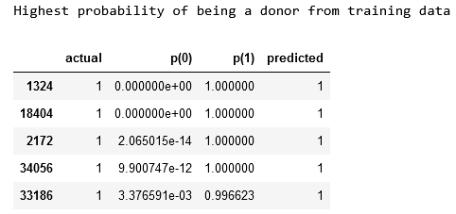
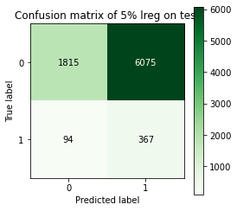
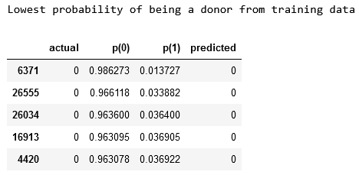
Model # 1: Creating and reviewing logistic regression

Slide 15
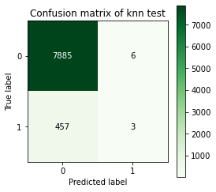
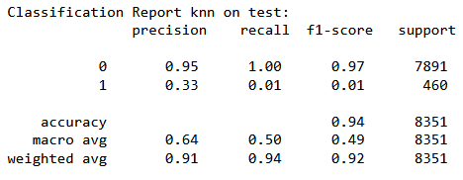
Model # 2: Creating and reviewing KNN
KNN model is not performing better than logistic regression on finding donors (predicted and true label 1)

Slide 16
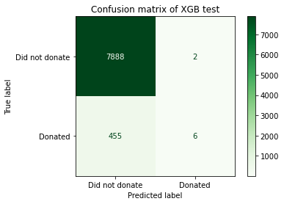
Model # 3: Creating and reviewing XGBoost
Although XGBoost is finding more donors than KNN model, it is not performing better than logistic regression on finding donors (predicted and true label 1)

Slide 17
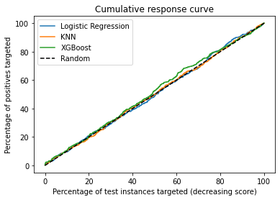
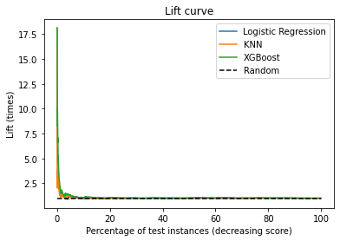
Evaluating the models
All three models performances were similar looking at cumulative response curve. However, logistic regression performed the best on this data set with the features engineered on finding true positive (actual donors). A drawback is that it also found many false positives for donors. This should be reviewed for implications of reaching out to donors who will not donate.
In reviewing the data, this organization had a very large churn where more than 92% of their donors did not donate the previous year. This makes it hard to learn and identify donor behavior. The donors could also be influenced by seasonality because they donate later in the year than at the point of this data collection.
More data and feature engineering could result in better performance especially giving data broken out by more fiscal years.

